Slide 1
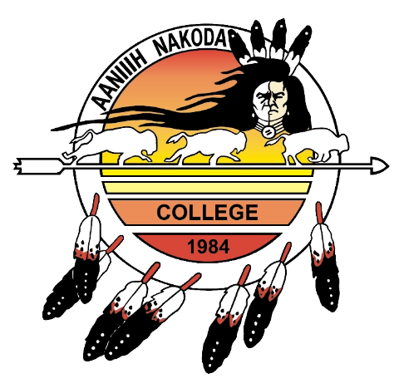
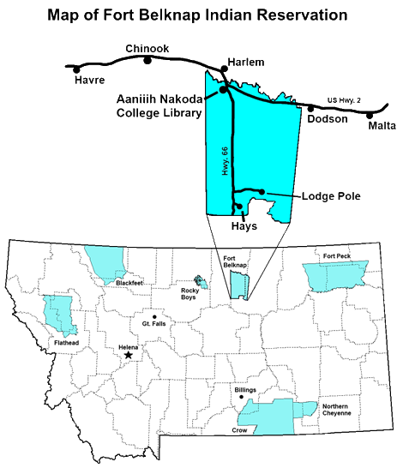
Aaniiih Nakoda College
The Aaniiih Nakoda College (ANC) Library serves as the academic library for ANC, as well as the public library for the Fort Belknap Indian Reservation (FBIR). Located in northcentral Montana, the FBIR is the home of the Aaniinen (White Clay People or Gros Ventre) and Nakoda (Assiniboine) Tribes.

Slide 2
Fort Belknap community members were surveyed to identify what they believe should be the library’s highest priority over the next two years. Their number one response was youth programming (20%), followed by STEM instruction (15%), and Native language, history and culture (10%).
Survey results from non-library users show the most frequent responses as Native language, history and culture (13%) and STEM (9%).
In order to address these community needs, the library has begun partnering with ANC students to host events wherein participants learn new skills related to Native American language, history and culture, and STEM related topics.
These events are called Makerspaces. During these events, participants of all ages are provided with a hands-on learning environment across a wide variety of subjects and activities.

Slide 3
By bringing elders and others who are knowledgeable in Native arts and crafts, to provide hands-on learning opportunities, more people will be able to carry on these traditions.
To support STEM activities, the ANC Library has partnered with MSU-Bozeman, through the NSF and Nanoscale Informal Science Education Network, to deliver the Explore Science program. This program offers STEM related activities using pre-made kits. The kits demonstrate to people of all ages the wonders of nano-science through everyday activities (circuits, stained glass, gravity, sand, etc.)

Slide 4
By providing hands-on instruction in areas determined to be of public interest, the Makerspaces provide a valuable opportunity for community members to learn new skills that can be carried on through generations. The ANC Library already acts as a community gathering place, so by providing this new service, it expands both the reach of the library and the knowledge of patrons.
By working with college students and community partners, the long-term success of the project is ensured. By bringing in new patrons, the library will continue to meet community needs by assessing then providing requested information and training.

Slide 5
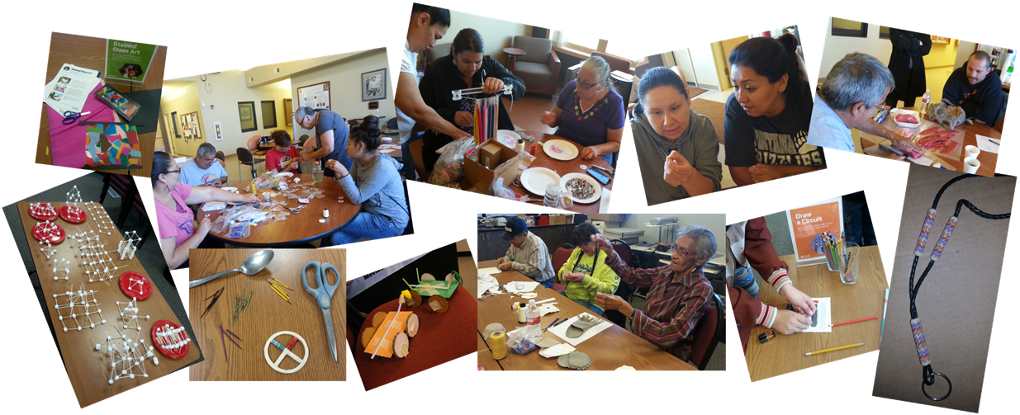
During recently held Makerspace events, community members of all ages have been provided hands-on exposure and training in things such as porcupine quillwork, preparing dry meat, beading, making moccasins, balloon powered vehicles, basic circuitry and engineering, and the nano-technology associated with stained glass windows.

